Slide 1
ML Tutorial Stem Cell Network
Abdul Muntakim Rafi

Slide 2
Today’s Task
Using publicly available machine learning models (Enformer, Vaishnav et al. 2022)
Training a neural network from scratch on sequence-to-expression MPRA data

Slide 3
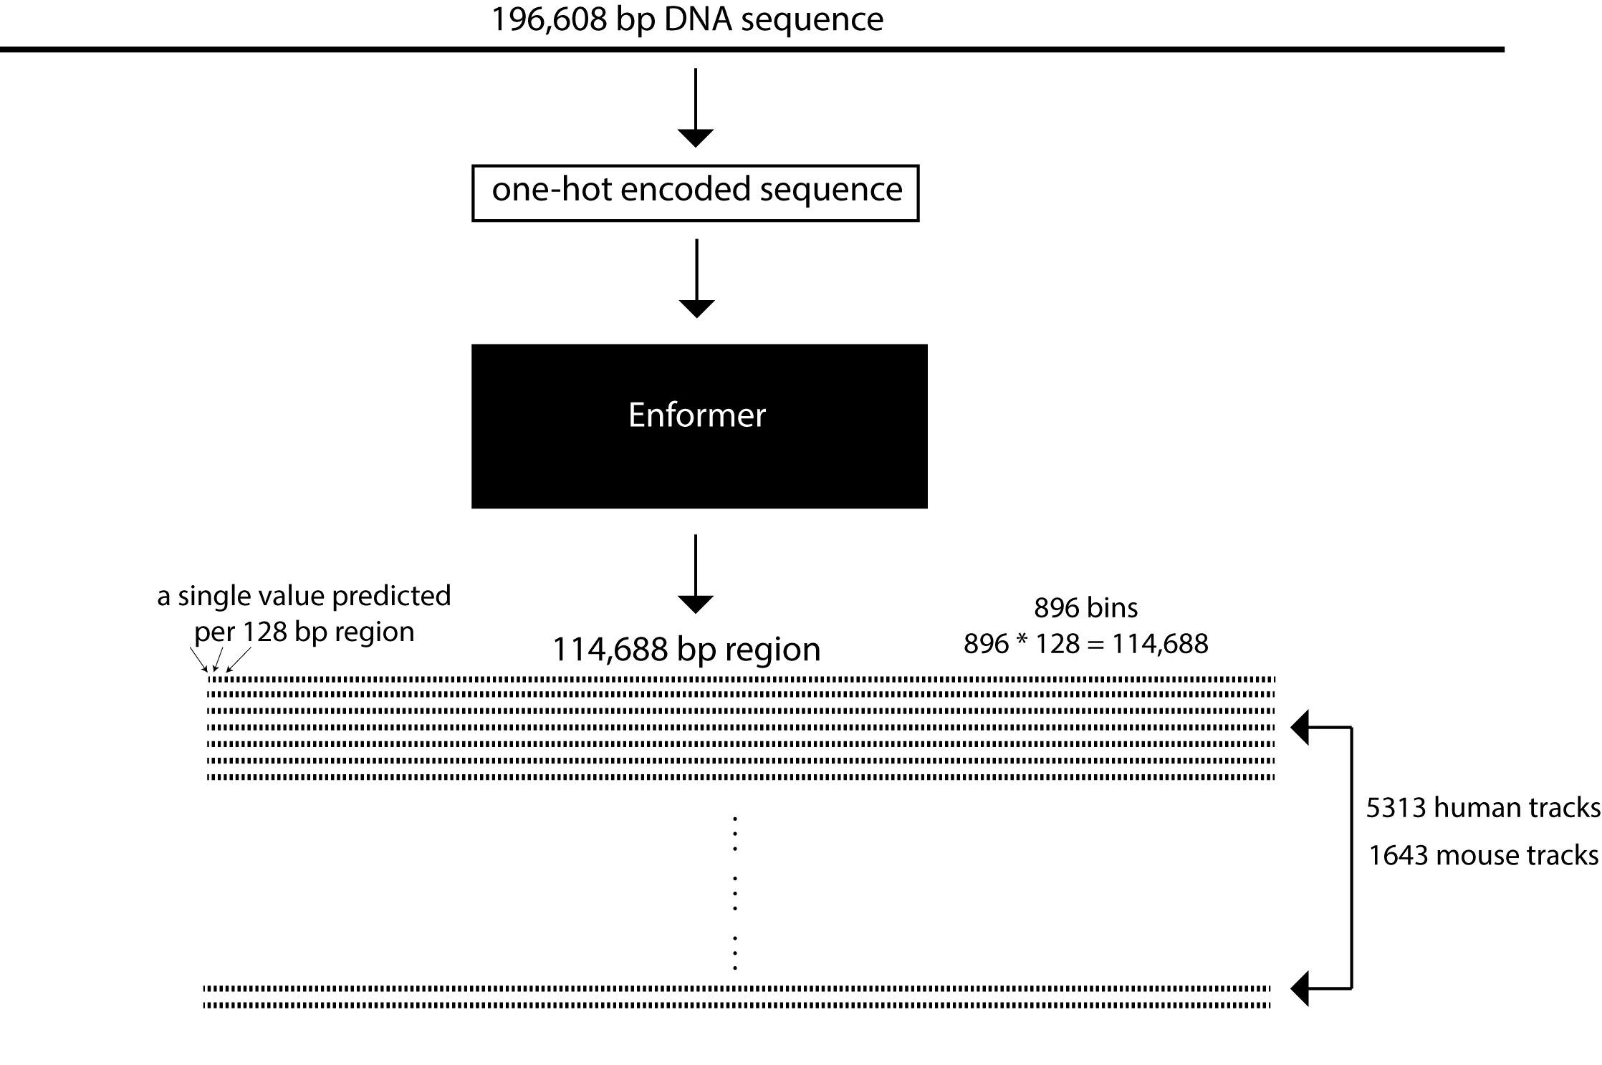
Enformer
Input: 196,608 bp
Output: 5313 human genomics tracks (e.g., CAGE, DNASE, CHIP, etc. in different cell types) for the center 114,688 bp and some mouse tracks
Output resolution is 128 bp

Slide 4
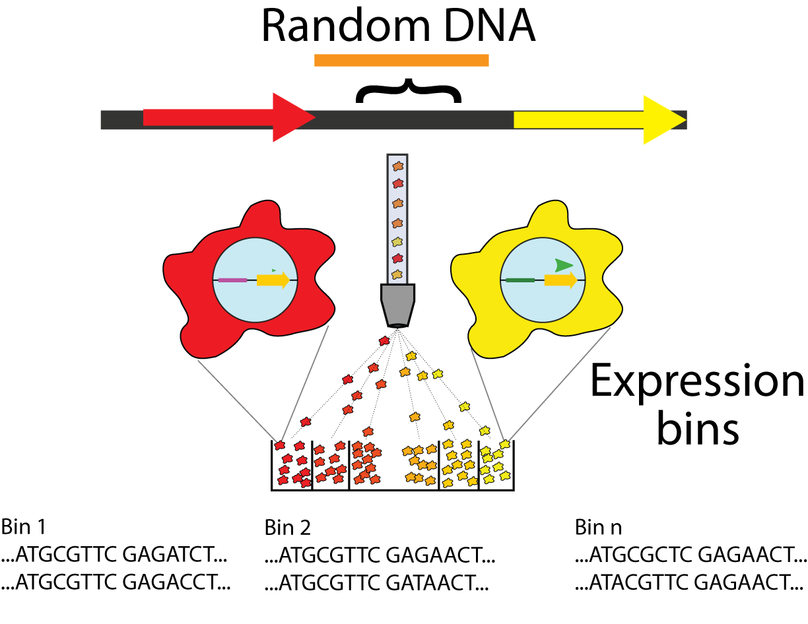
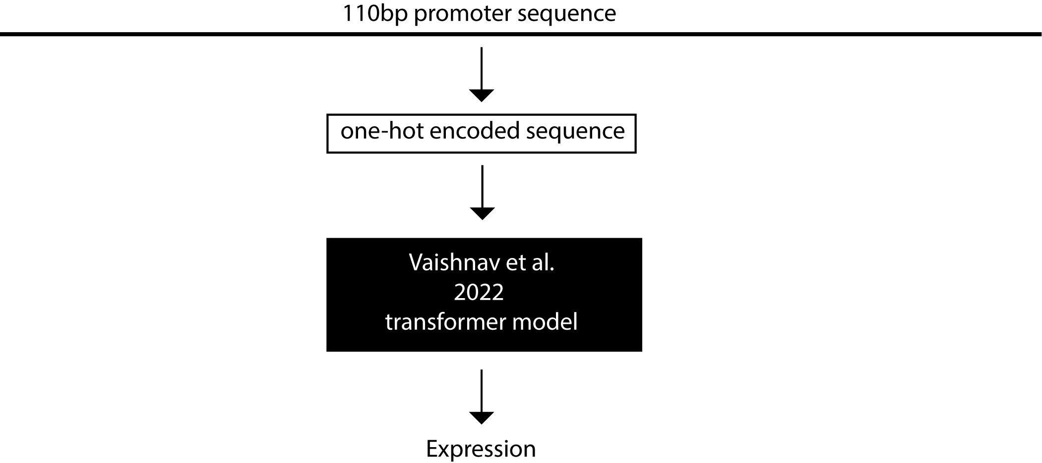
Vaishnav et al. 2022 transformer model
Input: 110 bp
Output: expression value for the YFP gene

Slide 5
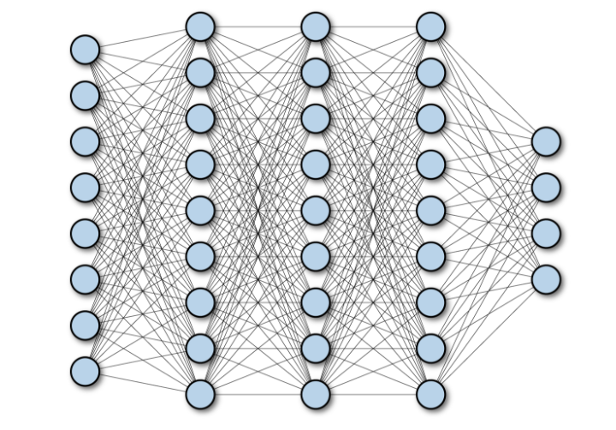
Fully Connected Layers

Slide 6
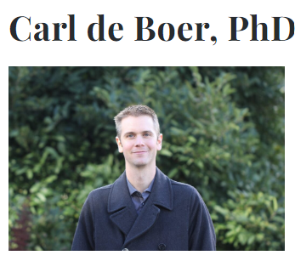

Acknowledgement
Arman Adel
If you find bugs in my code, please mail me: abdulmuntakim.rafi@ubc.ca

